Slide 1
Transcranial ultrasound stimulation at the peak-phase of theta-cycles in the hippocampus improve memory performance.
Asha Babu(5006025),Aswin Purathoottu Sibi(5006110),
Athira Chandran(5014914)
25/03/2024, HTW Saar, Germany./ Neural Signal Analysis and Modelling

Slide 2



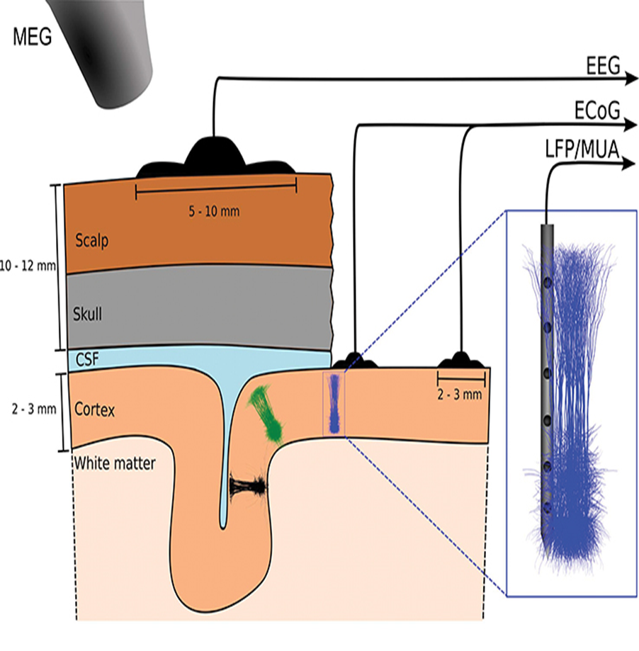
TUS at the peak-phase of theta-cycles in the hippocampus improve memory performance.
Introduction
Modelling of the Article
Exploration of neural dynamics and function.
Observation and characterization of neuronal responses to stimuli.
Research on neuron-to-neuron communication.
To examine interconnections, acquire local field potentials (LFPs) for analysis.
Introduction
Problem Analysis and Goals
Materials and Methods
Model
Results and Discussion
Conclusions and Future Work
References
Fig 1: LFP Recordings [5]
25.03.2024
2

Slide 3
TUS at the peak-phase of theta-cycles in the hippocampus improve memory performance.
Problem Analysis and Goals
To Investigate the effectiveness of closed-loop TUS on cognitive function and understand the underlying circuit mechanisms. [1]
This was achieved by administering closed-loop TUS to the CA1 region of the hippocampus at specific theta phases.[1]
Specific phase of theta rhythm (4-12 Hz) in the hippocampal CA1 region is thought to represent the encoding and retrieval phase of memory processing.[2]
Introduction
Problem Analysis and Goals
Materials and Methods
Model
Results and Discussion
Conclusions and Future Work
References
25.03.2024
3

Slide 4
TUS at the peak-phase of theta-cycles in the hippocampus improve memory performance.
Materials and Methods
20 male Sprague-Dawley rats - 160-220gms
peak stimulation (n=5), trough stimulation (n=5), random stimulation (n=5), and sham stimulation (n=5).[1]
Rats were gone through surgery. A part of the skull was resected at the upper part of rat hippocampal CA1 relative to bregma = -5.3 mm, ML = 3.4 mm, DV = –3 mm to expose an area of ​​approx.[1]
Introduction
Problem Analysis and Goals
Materials and Methods
Model
Results and Discussion
Conclusions and Future Work
References
25.03.2024
4
Notes:
medial lateral (ML) dorsal ventral (DV) = –3 mm

Slide 5
TUS at the peak-phase of theta-cycles in the hippocampus improve memory performance.
Materials and Methods
Position of electrodes [1]
16 channel electrodes - CA1 region
Reference and Ground Electrode - Nasal Bone
Ultrasound Parameters [1]
Frequency= 500 kHz, Stimulus duration= 50 ms,
CPP = 25000, Pulse Repetition Frequency = 1Hz
RP = 1s.
Introduction
Problem Analysis and Goals
Materials and Methods
Model
Results and Discussion
Conclusions and Future Work
References
25.03.2024
5
Notes:
medial lateral (ML) dorsal ventral (DV)
I_{sppa} = 8.66 W/cm²,I_{spta} = 0.43 W/cm²,
ΔT=2αIt/(ρ_{b}C_{p})∼3.8*10⁻³℃. Where α = 0.0175 cm⁻¹,
ρ_{b}C_{p} = 3.811J cm³C⁻¹, FWHM 5.6mm – 5.8mm

Slide 6
TUS at the peak-phase of theta-cycles in the hippocampus improve memory performance.
Materials and Methods
Kept the rats under anesthesia during the stimulation and kept the rats awake during the experiments evaluating memory ability.[1]
Y Maze [1]
-Three arms of black polypropylene walls (40 cm*10 cm*16 cm).
-Y-maze trajectories were recorded using a video tracking system in a quiet room.
The Y-maze behavior experiment was carried out after 7 days of ultrasound stimulation.
Introduction
Problem Analysis and Goals
Materials and Methods
Model
Results and Discussion
Conclusions and Future Work
References
25.03.2024
6
Notes:
medial lateral (ML) dorsal ventral (DV)
I_{sppa} = 8.66 W/cm²,I_{spta} = 0.43 W/cm²,
ΔT=2αIt/(ρ_{b}C_{p})∼3.8*10⁻³℃. Where α = 0.0175 cm⁻¹,
ρ_{b}C_{p} = 3.811J cm³C⁻¹, FWHM 5.6mm – 5.8mm

Slide 7
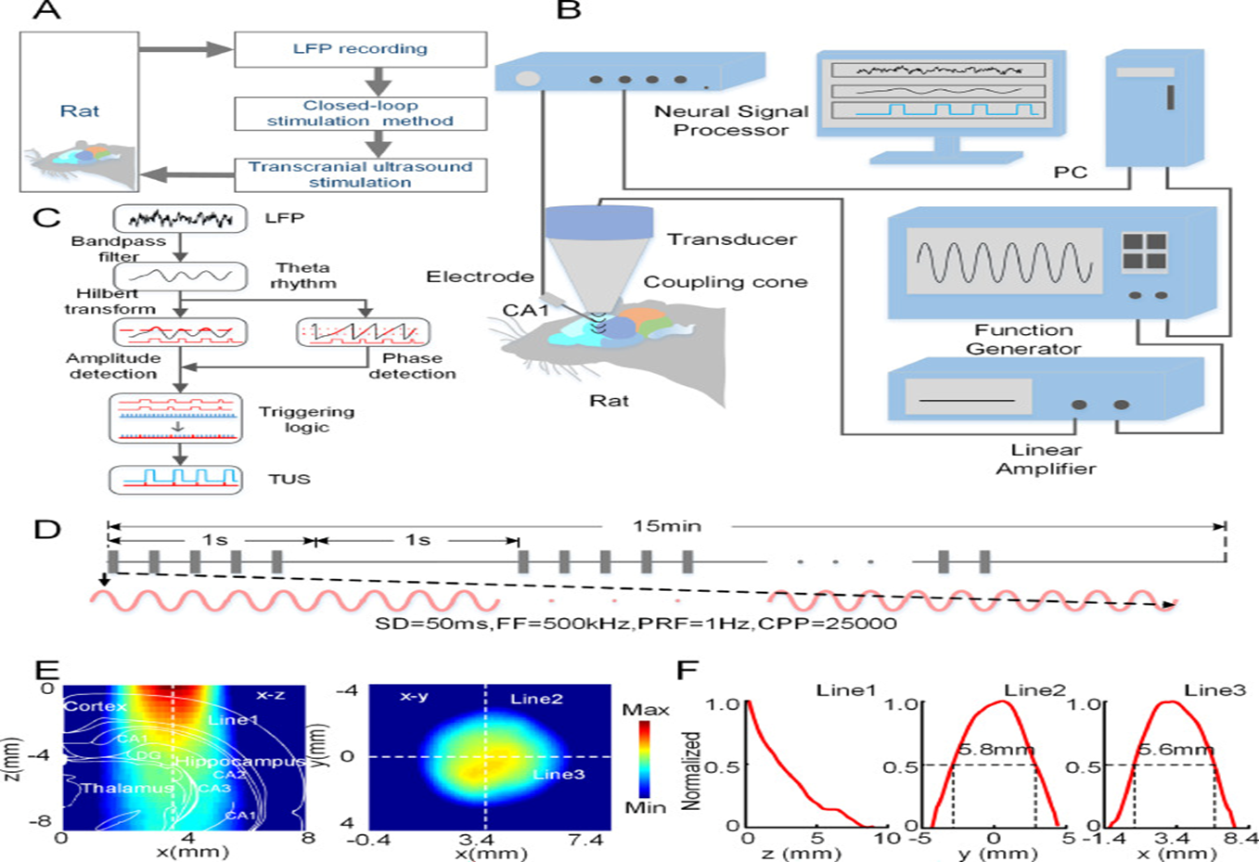
TUS at the peak-phase of theta-cycles in the hippocampus improve memory performance.
Materials and Methods
Introduction
Problem Analysis and Goals
Materials and Methods
Model
Results and Discussion
Conclusions and Future Work
References
Fig 2: Recording layout [1]
25.03.2024
7
Notes:
medial lateral (ML) dorsal ventral (DV)
I_{sppa} = 8.66 W/cm²,I_{spta} = 0.43 W/cm²,
ΔT=2αIt/(ρ_{b}C_{p})∼3.8*10⁻³℃. Where α = 0.0175 cm⁻¹,
ρ_{b}C_{p} = 3.811J cm³C⁻¹, FWHM 5.6mm – 5.8mm

Slide 8
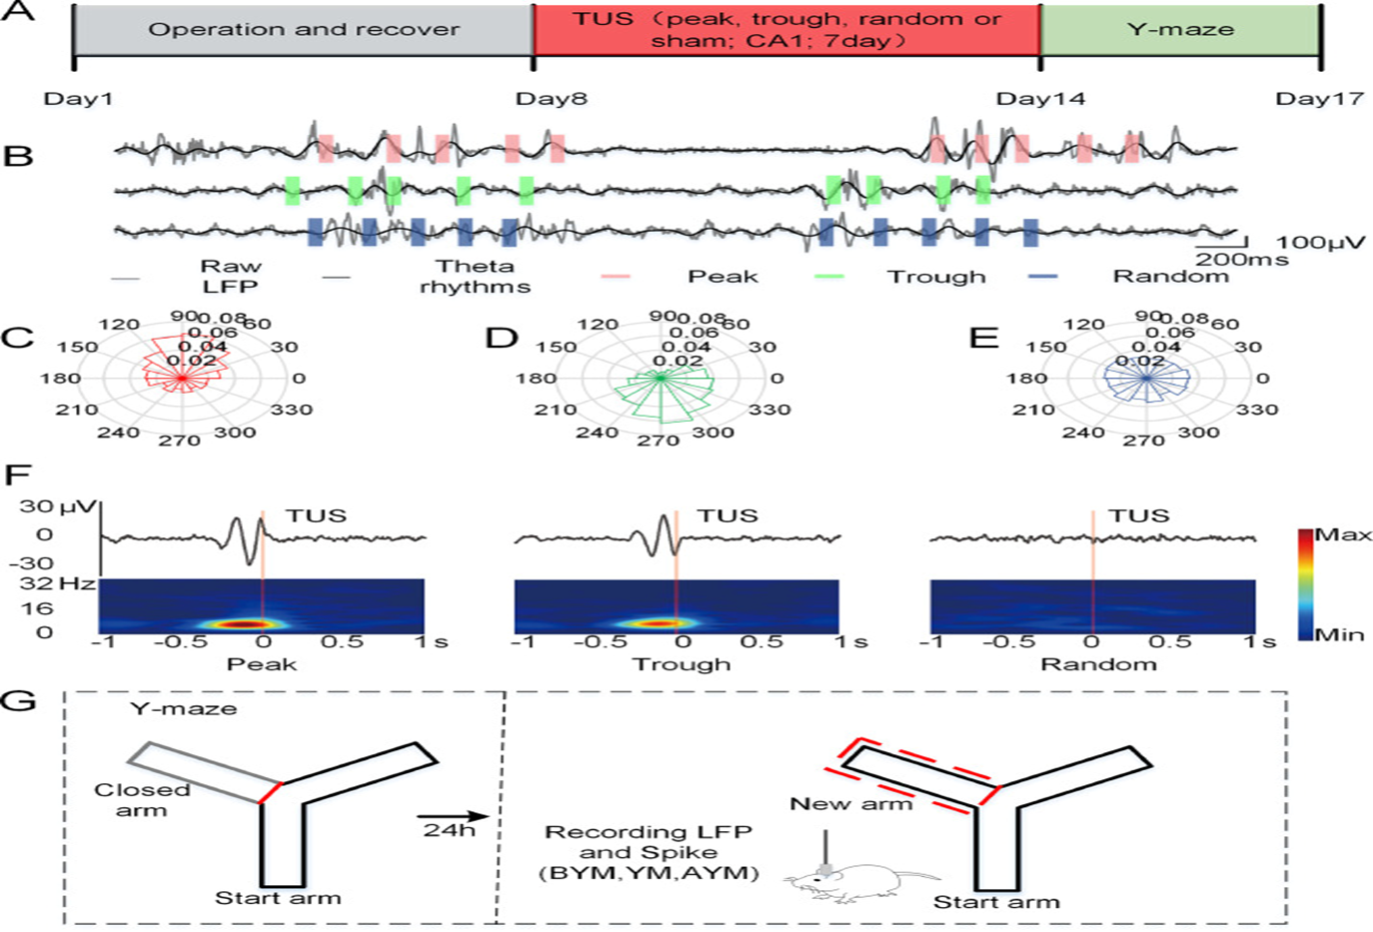
TUS at the peak-phase of theta-cycles in the hippocampus improve memory performance.
Materials and Methods
Introduction
Problem Analysis and Goals
Materials and Methods
Model
Results and Discussion
Conclusions and Future Work
References
Fig 3: (A)Experimental schedule, (B) Schematic diagram of closed-loop phase-locked ultrasound stimulation of theta rhythm peaks and troughs or random stimulation. (C-E) Phase distribution of ultrasound-stimulated theta rhythm, peak and trough (F) Stimulation triggered average waveform and frequency spectrum. (G) The new arm exploration experiment of the Y-maze[1]
25.03.2024
8

Slide 9
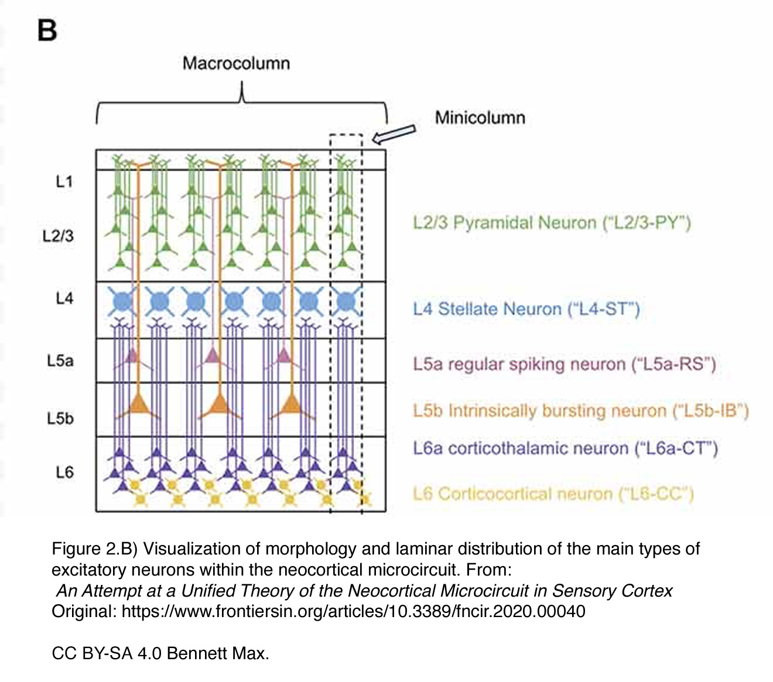
TUS at the peak-phase of theta-cycles in the hippocampus improve memory performance.
Model
Introduction
Problem Analysis and Goals
Materials and Methods
Model
Results and Discussion
Conclusions and Future Work
References
Fig 4: Cortical laminae[21]
25.03.2024
9

Slide 10
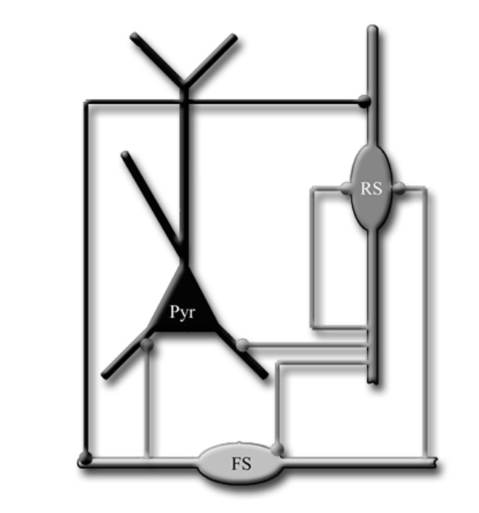
TUS at the peak-phase of theta-cycles in the hippocampus improve memory performance.
Model
Introduction
Problem Analysis and Goals
Materials and Methods
Model
Results and Discussion
Conclusions and Future Work
References
Fig 5: Blueprint of neuron model[20]
25.03.2024
10

Slide 11
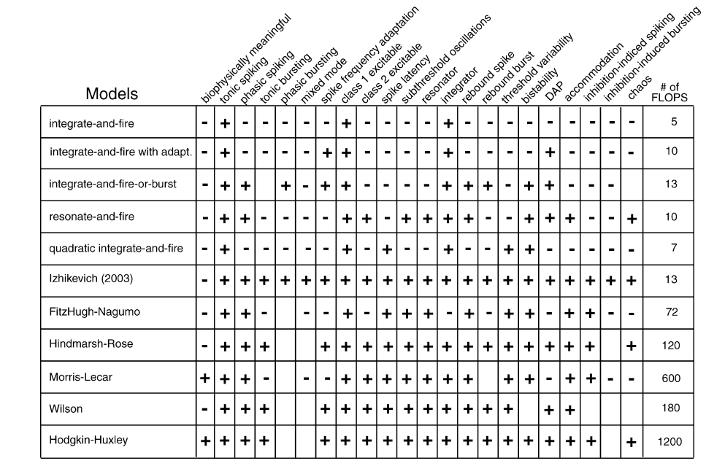
TUS at the peak-phase of theta-cycles in the hippocampus improve memory performance.
Model
Introduction
Problem Analysis and Goals
Materials and Methods
Model
Results and Discussion
Conclusions and Future Work
References
Table 1: Comparison of the neuro-computational properties of different models[14]
25.03.2024
11

Slide 12
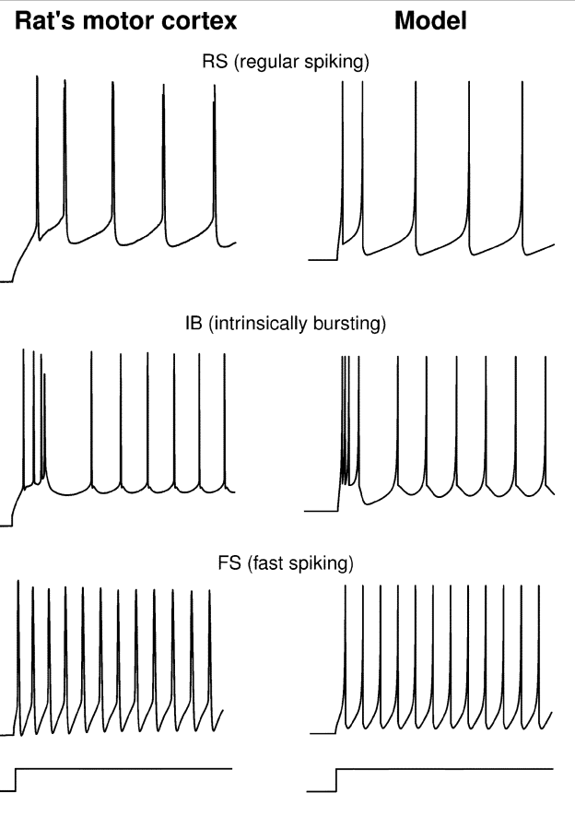
TUS at the peak-phase of theta-cycles in the hippocampus improve memory performance.
Model
Izhikevich Model[15]
v’ = 0.04v²+ 5v + 140 - u + I
u’ = a(bv-u)
v←c
if v >= 30 mV
u←u+d
v,u- dimentionless variables
a,b,c,d- dimentionless
parameters.
Introduction
Problem Analysis and Goals
Materials and Methods
Model
Results and Discussion
Conclusions and Future Work
References
Fig 6: Firing patterns of neurons [15]
25.03.2024
12

Slide 13
TUS at the peak-phase of theta-cycles in the hippocampus improve memory performance.
Model
Izhikevich Model[15]
v’ = 0.04v²+ 5v + 140 - u + I
u’ = a(bv-u)
v←c
if v >= 30 mV
u←u+d
v - Membrane potential activation K+
u - Recovery Variable inactivation Na+
I - Synaptic Current
a - time scale of u (typical value = 0.02)
b - sensitivity of u (typical value = 0.2)
c - after-spike reset value of v (typical value = -65 mV)
d - after- spike reset of u (typical value = 2)
Introduction
Problem Analysis and Goals
Materials and Methods
Model
Results and Discussion
Conclusions and Future Work
References
25.03.2024
13

Slide 14
TUS at the peak-phase of theta-cycles in the hippocampus improve memory performance.
Model
Izhikevich Model[15]
v’ = 0.04v²+ 5v + 140 - u + I
u’ = a(bv-u)
v←c
if v >= 30 mV
u←u+d
Introduction
Problem Analysis and Goals
Materials and Methods
Model
Results and Discussion
Conclusions and Future Work
References
 | Pyramidal | Fast Spiking | Regular Spiking
a | 0.02 | 0.1 | 0.02
b | 0.2 | 0.2 | 0.25
c | -65mV | -65mV | -65mV
d | 8 | 2 | 2
Table 2: Neuron parameters[15]
25.03.2024
14

Slide 15
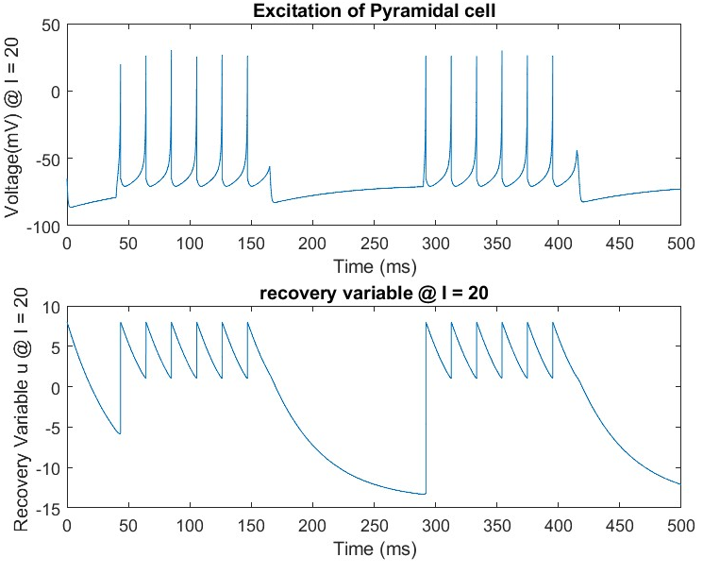
TUS at the peak-phase of theta-cycles in the hippocampus improve memory performance.
Results
Introduction
Problem Analysis and Goals
Materials and Methods
Model
Results and Discussion
Conclusions and Future Work
References
Fig 7: Excitation of pyramidal cell and the recovery variable
25.03.2024
15
Notes:
micro ampere/ cm^2

Slide 16
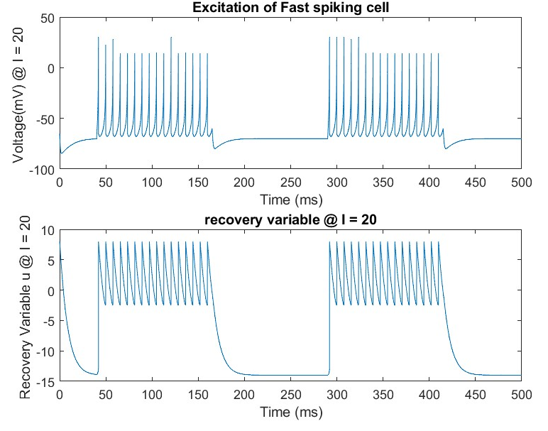
TUS at the peak-phase of theta-cycles in the hippocampus improve memory performance.
Results
Introduction
Problem Analysis and Goals
Materials and Methods
Model
Results and Discussion
Conclusions and Future Work
References
Fig 8: Excitation of fast spiking cell and the recovery variable
25.03.2024
16

Slide 17
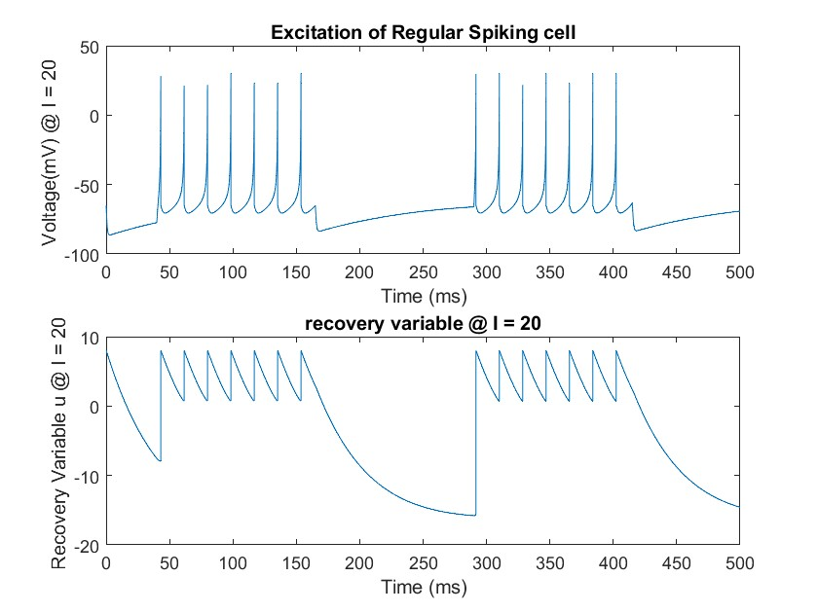
TUS at the peak-phase of theta-cycles in the hippocampus improve memory performance.
Results
Introduction
Problem Analysis and Goals
Materials and Methods
Model
Results and Discussion
Conclusions and Future Work
References
Fig 9: Excitation of regular spiking cell and the recovery variable
25.03.2024
17

Slide 18
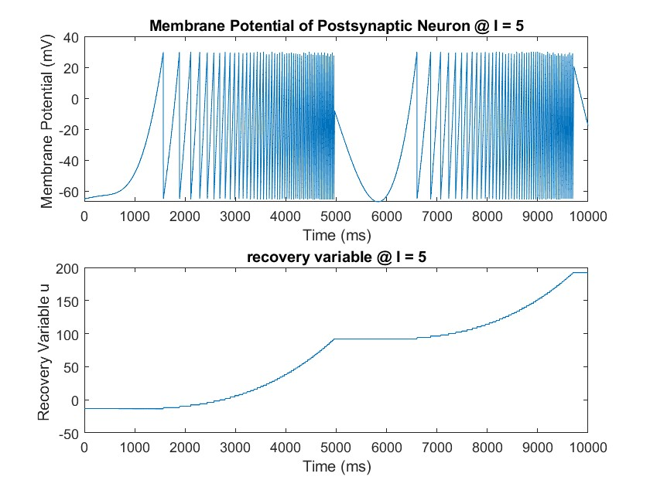
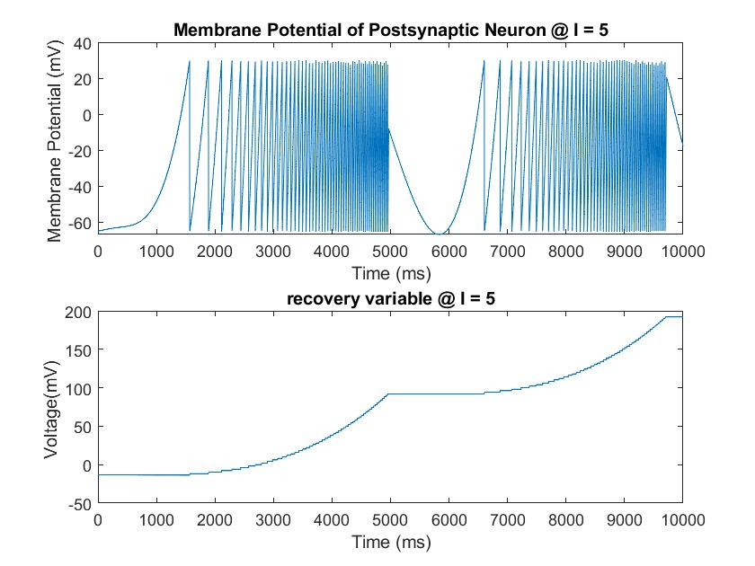
TUS at the peak-phase of theta-cycles in the hippocampus improve memory performance.
Results
Introduction
Problem Analysis and Goals
Materials and Methods
Model
Results and Discussion
Conclusions and Future Work
References
Fig 10: Membrane potential and recovery variable of postsynaptic neuron @I = 5
25.03.2024
18

Slide 19
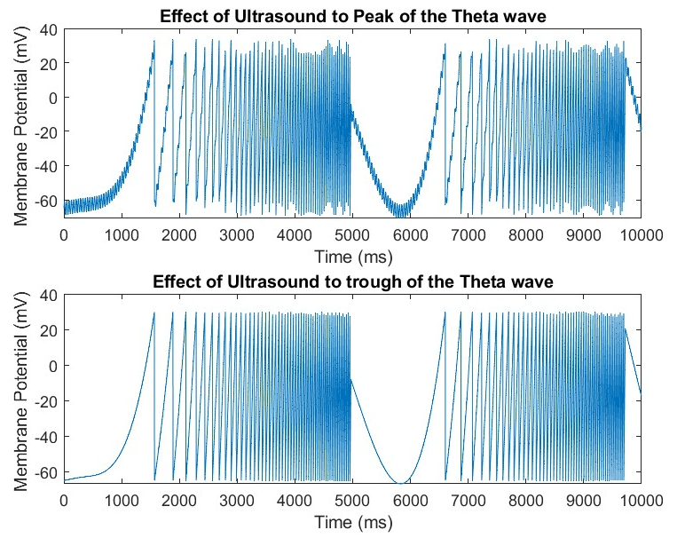
TUS at the peak-phase of theta-cycles in the hippocampus improve memory performance.
Results
Introduction
Problem Analysis and Goals
Materials and Methods
Model
Results and Discussion
Conclusions and Future Work
References
Fig 11: Effect of Ultrasound in peak and trough @I=5
25.03.2024
19

Slide 20
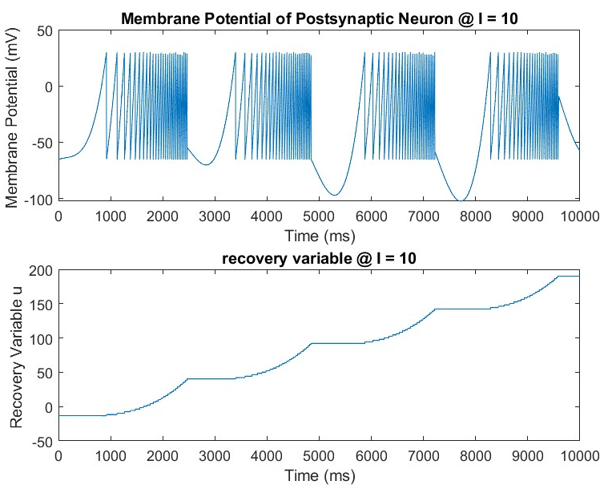
TUS at the peak-phase of theta-cycles in the hippocampus improve memory performance.
Results
Introduction
Problem Analysis and Goals
Materials and Methods
Model
Results and Discussion
Conclusions and Future Work
References
Fig 12: Membrane potential and recovery variable of postsynaptic neuron @I = 10
25.03.2024
20

Slide 21
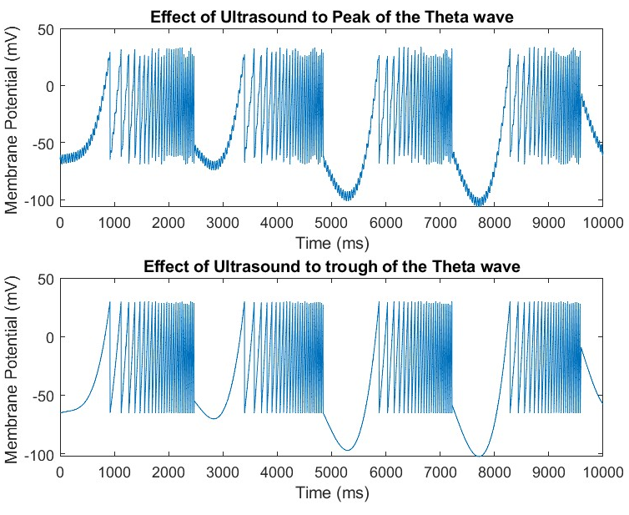
TUS at the peak-phase of theta-cycles in the hippocampus improve memory performance.
Results
Introduction
Problem Analysis and Goals
Materials and Methods
Model
Results and Discussion
Conclusions and Future Work
References
Fig 13: Effect of Ultrasound in peak and trough @I=10
25.03.2024
21

Slide 22
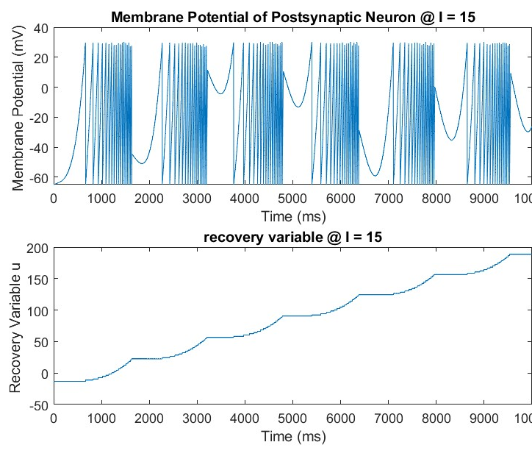
TUS at the peak-phase of theta-cycles in the hippocampus improve memory performance.
Results
Introduction
Problem Analysis and Goals
Materials and Methods
Model
Results and Discussion
Conclusions and Future Work
References
Fig 14: Membrane potential and recovery variable of postsynaptic neuron @I = 15
25.03.2024
22

Slide 23
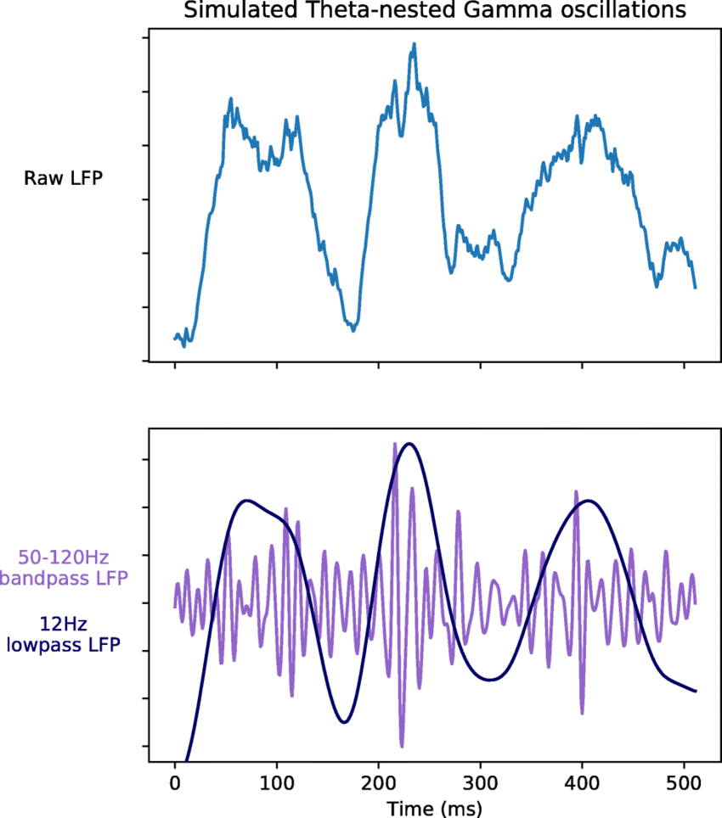
TUS at the peak-phase of theta-cycles in the hippocampus improve memory performance.
Results
Introduction
Problem Analysis and Goals
Materials and Methods
Model
Results and Discussion
Conclusions and Future Work
References
Fig 15: Normal theta nested gamma oscillations[22]
25.03.2024
23

Slide 24
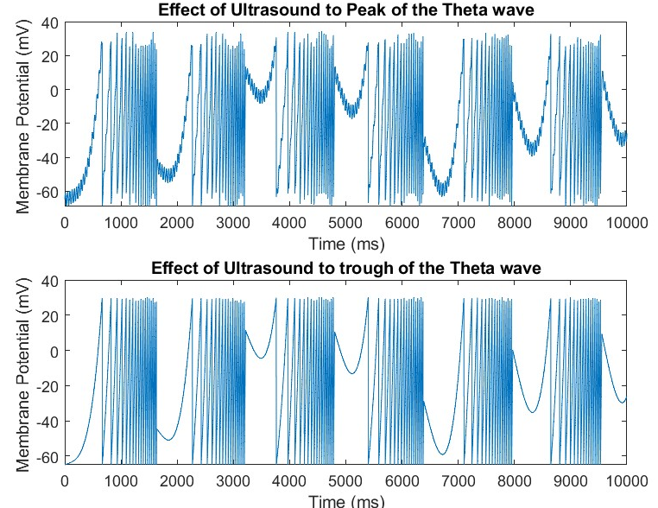
TUS at the peak-phase of theta-cycles in the hippocampus improve memory performance.
Results
Introduction
Problem Analysis and Goals
Materials and Methods
Model
Results and Discussion
Conclusions and Future Work
References
Fig 16: Effect of Ultrasound in peak and trough @I=15
25.03.2024
24

Slide 25
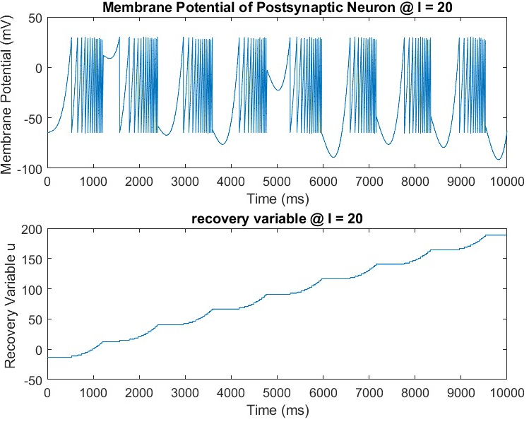
TUS at the peak-phase of theta-cycles in the hippocampus improve memory performance.
Results
Introduction
Problem Analysis and Goals
Materials and Methods
Model
Results and Discussion
Conclusions and Future Work
References
Fig 17: Membrane potential and recovery variable of postsynaptic neuron @I = 20
25.03.2024
25

Slide 26
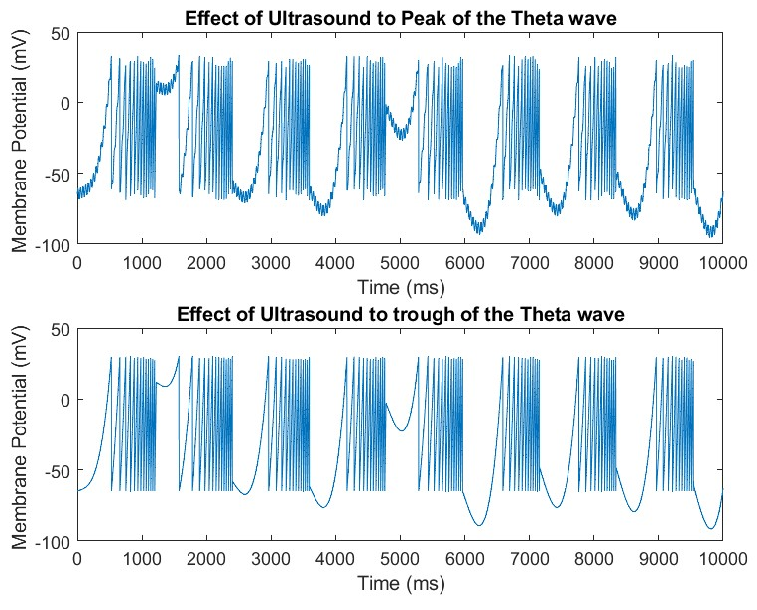
TUS at the peak-phase of theta-cycles in the hippocampus improve memory performance.
Results
Introduction
Problem Analysis and Goals
Materials and Methods
Model
Results and Discussion
Conclusions and Future Work
References
Fig 18: Effect of Ultrasound in peak and trough @I=20
25.03.2024
26

Slide 27
TUS at the peak-phase of theta-cycles in the hippocampus improve memory performance.
Discussion
Introduction
Problem Analysis and Goals
Materials and Methods
Model
Results and Discussion
Conclusions and Future Work
References
Implemented the Izhikevich model according to the model parameters.
Observed nested theta-gamma oscillations.
Modelled the memory enhancements as the application of the US in peak, demonstrates its excitatory effect.
As well as application of US in trough, demonstrates its inhibitory effect.
25.03.2024
27

Slide 28
TUS at the peak-phase of theta-cycles in the hippocampus improve memory performance.
Conclusions
Attained the expertise to discern the ideal neuron model tailored to diverse model requirements.
Capable of integrating theoretical concepts with practical applications in a computational framework.
Evaluated the advantages and drawbacks of model through systematic analysis.
Obtained a comprehensive understanding of IPSP and EPSP across various neuron types.
Introduction
Problem Analysis and Goals
Materials and Methods
Model
Results and Discussion
Conclusions and Conclusions and Future work
References
25.03.2024
28

Slide 29
TUS at the peak-phase of theta-cycles in the hippocampus improve memory performance.
Future Work
Studies can be elicited to conduct human trials after addressing ethical considerations.
The Model can undergo revision and strategic adjustments to enhance efficiency and effectiveness.
The Model can be further refined by incorporating a greater number of neurons into consideration, thereby improving comprehensiveness and accuracy.
Evaluating the efficiency of TUS in clinical populations with memory impairments such as Alzheimer's, memory loss, mild cognitive impairment, etc.
Introduction
Problem Analysis and Goals
Materials and Methods
Model
Results and Discussion
Conclusions and Conclusions and Future work
References
25.03.2024
29

Slide 30
TUS at the peak-phase of theta-cycles in the hippocampus improve memory performance.
References
Xie Z, Dong S, Zhang Y, Yuan Y. Transcranial ultrasound stimulation at the peak-phase of theta-cycles in the hippocampus improve memory performance. Neuroimage. 2023 Dec 1;283:120423. doi: 10.1016/j.neuroimage.2023.120423. Epub 2023 Oct 24. PMID: 37884166.
Michael E. Hasselmo, Clara Bodelón, Bradley P. Wyble; A Proposed Function for Hippocampal Theta Rhythm: Separate Phases of Encoding and Retrieval Enhance Reversal of Prior Learning. Neural Comput 2002; 14 (4): 793–817. doi: https://doi.org/10.1162/089976602317318965
Hagen E, Næss S, Ness TV, Einevoll GT. Multimodal Modeling of Neural Network Activity: Computing LFP, ECoG, EEG, and MEG Signals With LFPy 2.0. Front Neuroinform. 2018 Dec 18;12:92. doi: 10.3389/fninf.2018.00092. PMID: 30618697; PMCID: PMC6305460.
Introduction
Problem Analysis and Goals
Materials and Methods
Model
Results and Discussion
Conclusions and Future Work
References
25.03.2024
30

Slide 31
TUS at the peak-phase of theta-cycles in the hippocampus improve memory performance.
References
Reimann MW, Anastassiou CA, Perin R, Hill SL, Markram H, Koch C. A biophysically detailed model of neocortical local field potentials predicts the critical role of active membrane currents. Neuron. 2013 Jul 24;79(2):375-90. doi: 10.1016/j.neuron.2013.05.023. PMID: 23889937; PMCID: PMC3732581.
Local field potential – Scholarpedia
Canolty RT, Knight RT. The functional role of cross-frequency coupling. Trends Cogn Sci. 2010 Nov;14(11):506-15. doi: 10.1016/j.tics.2010.09.001. PMID: 20932795; PMCID: PMC3359652.
https://www.statisticssolutions.com/free-resources/directory-of-statistical-analyses/kruskal-wallis-test/
Introduction
Problem Analysis and Goals
Materials and Methods
Model
Results and Discussion
Conclusions and Future Work
References
25.03.2024
31

Slide 32
TUS at the peak-phase of theta-cycles in the hippocampus improve memory performance.
References
Lee S, Lee DK. What is the proper way to apply the multiple comparison test? Korean J Anesthesiol. 2018 Oct;71(5):353-360. doi: 10.4097/kja.d.18.00242. Epub 2018 Aug 28. Erratum in: Korean J Anesthesiol. 2020 Dec;73(6):572. PMID: 30157585; PMCID: PMC6193594.
Tort AB, Rotstein HG, Dugladze T, Gloveli T, Kopell NJ. (2007). On the formation of gamma-coherent cell assemblies by oriens lacunosum-moleculare interneurons in the hippocampus. Proceedings of the National Academy of Sciences of the United States of America.
Zheng Y, Luo JJ, Harris S, Kennerley A, Berwick J, Billings SA, Mayhew J. Balanced excitation and inhibition: model based analysis of local field potentials. Neuroimage. 2012 Oct 15;63(1):81-94. doi: 10.1016/j.neuroimage.2012.06.040. Epub 2012 Jun 30. PMID: 22759993.
Introduction
Problem Analysis and Goals
Materials and Methods
Model
Results and Discussion
Conclusions and Future Work
References
25.03.2024
32

Slide 33
TUS at the peak-phase of theta-cycles in the hippocampus improve memory performance.
References
Einevoll, G.T., Wójcik, D.K. & Destexhe, A. Modeling extracellular potentials. J Comput Neurosci 29, 367–369 (2010). https://doi.org/10.1007/s10827-010-0283-y
https://corporatefinanceinstitute.com/resources/data-science/autocorrelation/
Shahriari S, Garcia D. Meshfree simulations of ultrasound vector flow imaging using smoothed particle hydrodynamics. Phys Med Biol. 2018 Oct 17;63(20):205011. doi: 10.1088/1361-6560/aae3c3. PMID: 30247153.
E. M. Izhikevich, "Which model to use for cortical spiking neurons?," in IEEE Transactions on Neural Networks, vol. 15, no. 5, pp. 1063-1070, Sept. 2004, doi: 10.1109/TNN.2004.832719
E. M. Izhikevich, "Simple model of spiking neurons," in IEEE Transactions on Neural Networks, vol. 14, no. 6, pp. 1569-1572, Nov. 2003, doi: 10.1109/TNN.2003.820440.
Introduction
Problem Analysis and Goals
Materials and Methods
Model
Results and Discussion
Conclusions and Future Work
References
25.03.2024
33

Slide 34
TUS at the peak-phase of theta-cycles in the hippocampus improve memory performance.
References
Guo, H., Hamilton, M., Offutt, S.J., Gloeckner, C.D., Li, T., Kim, Y., Legon, W., Alford, J. K., Lim, H.H., 2018. Ultrasound produces extensive brain activation via a cochlear pathway. Neuron 98, 1020–1030 e1024.
Alejandro Javier Pernía-Andrade, Peter Jonas,Theta-Gamma-Modulated Synaptic Currents in Hippocampal Granule Cells In Vivo Define a Mechanism for Network Oscillations,Neuron, Volume 81, Issue 1, 2014, Pages 140-152, ISSN 0896-6273
Dong S, Yan J, Xie Z, Yuan Y, Ji H. Modulation effect of mouse hippocampal neural oscillations by closed-loop transcranial ultrasound stimulation. J Neural Eng. 2022 Dec 16;19(6). doi: 10.1088/1741-2552/aca799. PMID: 36541474.
Weinreb, E., Moses, E., 2022. Mechanistic insights into ultrasonic neurostimulation of disconnected neurons using single short pulses. Brain Stimul. 15, 769–779.
Introduction
Problem Analysis and Goals
Materials and Methods
Model
Results and Discussion
Conclusions and Future Work
References
25.03.2024
34

Slide 35
TUS at the peak-phase of theta-cycles in the hippocampus improve memory performance.
References
Laar Haab, 2015. Numerical Modeling and Experimental Validation of Involuntary Attentional Capture and Long–Term Habituation by the example of Tinnitus Aurium.
Bennett M. An Attempt at a Unified Theory of the Neocortical Microcircuit in Sensory Cortex. Front Neural Circuits. 2020 Jul 28;14:40. doi: 10.3389/fncir.2020.00040. PMID: 32848632; PMCID: PMC7416357.
Aussel A, Buhry L, Tyvaert L, Ranta R. A detailed anatomical and mathematical model of the hippocampal formation for the generation of sharp-wave ripples and theta-nested gamma oscillations. J Comput Neurosci. 2018 Dec;45(3):207-221. doi: 10.1007/s10827-018-0704-x. Epub 2018 Oct 31. PMID: 30382451.
Introduction
Problem Analysis and Goals
Materials and Methods
Model
Results and Discussion
Conclusions and Future Work
References
25.03.2024
35

Slide 36
Thank you very much for your attention !
25.03.2024
Asha Babu, Aswin Purathoottu Sibi, Athira Chandran

